Slide 1
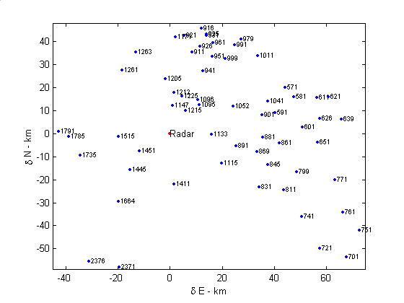
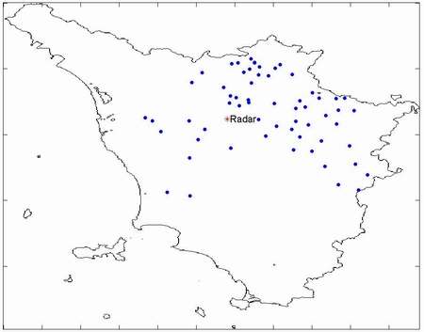
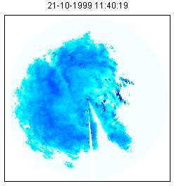
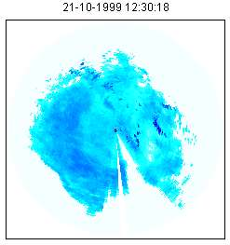
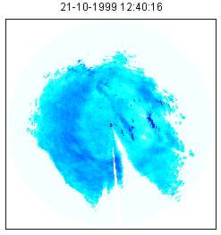
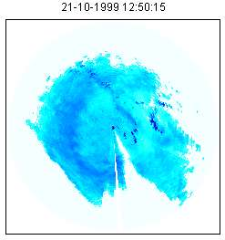
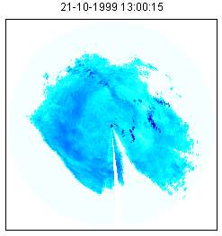
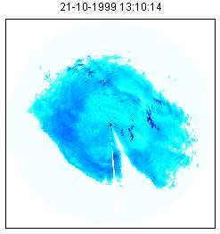
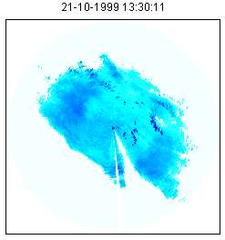
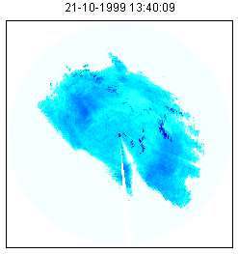
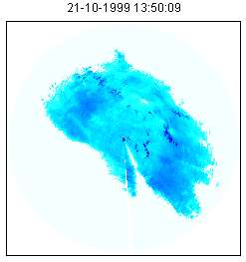
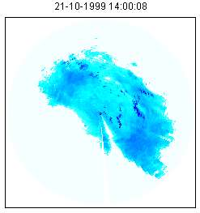
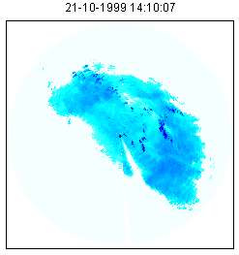
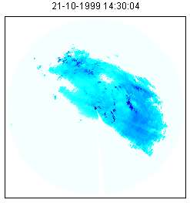
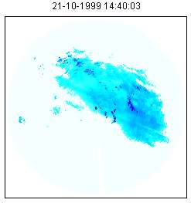
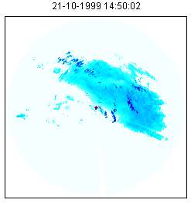
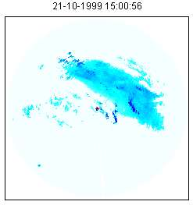
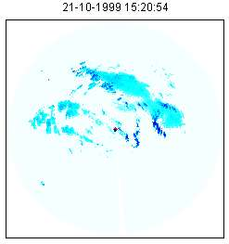
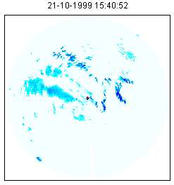
Spatial distribution of sensors
Raingauge 1095
(16.764 km)
(NEst)
Raingauge 1791
(42.675 km)
West
Polar55C
Dual Polarization Doppler radar
A geographical area (Arno basin, Tuscany, Italy) covered by one weather radar and a raingauge network (60 raingauges) - 1999
Notes:
Here we have an example of the spatial distibution of the measurement instruments in a rectangular area where the 0,0 reference corresponds to the radar location.
This is the real distribution of the active instruments in 1999 in the basin of the Arno river in Tuscany: (press!) one meteorological radar operating in C band, dual polarization and a network composed by 60 raingauge stations.
(press!) The two evidenced raingauage have been selected for some of the following data processing examples: (press!) the former is located 16 km far from the radar in NE direction and the latter is located 41km in West direction.

Slide 2
Objectives...
The computation of the average rainfall rate field R_{T}(x,y) using a power law relationship and
a space-time averaged radar reflectivity Z_{T}(x,y)
Observation time
Functions of raingauge and radar data
Function of radar data
All data acquired during the precipitation phenomenon in the observation time T are used in the data processing procedure
Notes:
Let us recall that our main objective is the estimation of the rainfall rate R. (press!) We want to compute such rainfall rate using a liner relationship between the logarithm of R and the logarithm of a function ZT (press!) that depends on the horizontal reflectivity radar data.
The choice of the linear logarithmic relationship is due to the fact that in radar meteorology the most used relation between rainfall rate and radar reflectivity is a power law.
Therefore, in order to estimate the rainfall rate using this eq we must determine 3 functions AT BT (press!) and ZT. We decided to determine the functions AT and BT using both radar and raingauge data (press!) while the function ZT will depend only on the radar data.
The pedix T (press!) means that all the data processing procedures are made considering a given T as processing time. (press!) In other words RT is the averaged rainfall rate in T and AT BT and ZT (press!) are computed on the base of all data (raingauge and radar) collected during T.

Slide 3
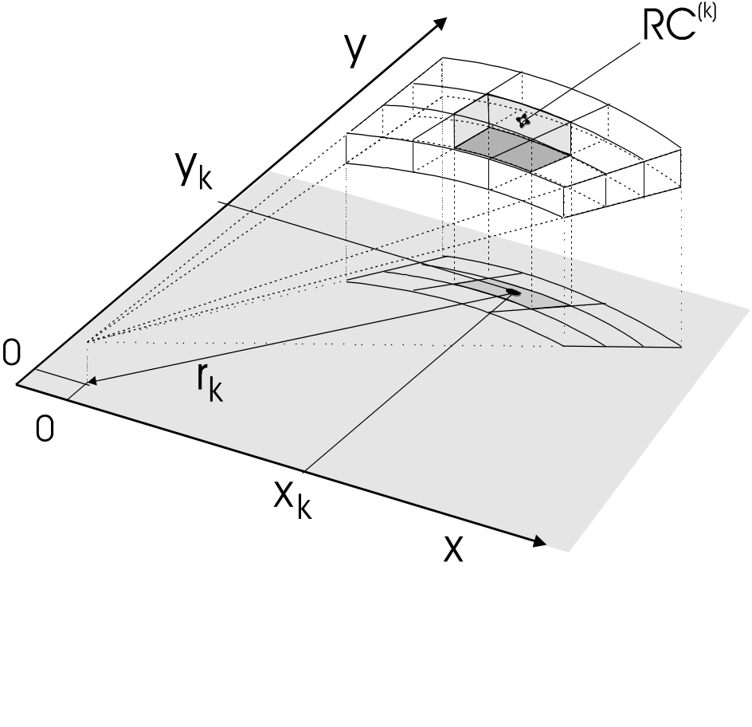
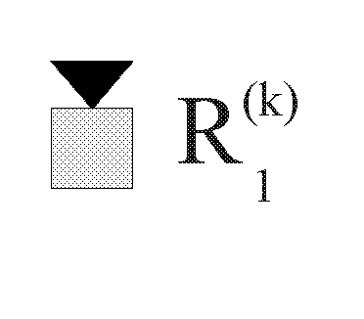
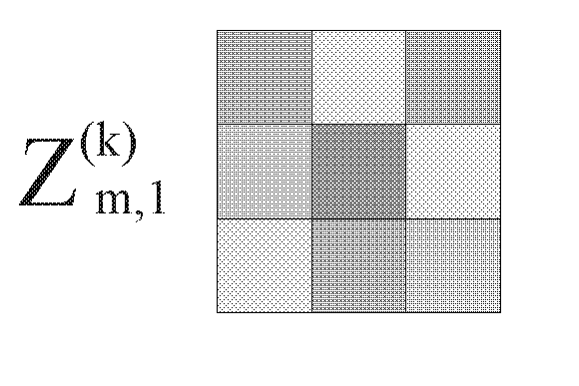
Radar and raingauge data
l is the time index
m is the space index
Radar position
m=1..N_{z} (N_{z} is the number of adjacent radar cells)
Notes:
Let us recall how the dataset is composed, considering that the radar is located in 0,0 (press!)
The radar data is a set of horizontal instantaneous reflectivity data. For each raingauge location xk,yk (press!) and at a prefixed radar elevation angle a radar cell RCK is identified. (press!) on the vertical of the raingauge. Then, a set of adjacent cells is defined (press!). Such set is composed by the radar cells that, at the same elevation angle, surround the RCK cell.
(press!) Therefore the radar data related to a raingauge location is represented by a squared matrix of horizontal reflectivity data Z M L K. Considering for example 9 adjacent cells, we have 9 reflectivity radar data, m=1 to 9, for the instant l for each rain gauge location k. (press!)
The raingauge dataset (press!) is simply a time series of cumulated rainfall rate given each instant l.

Slide 4
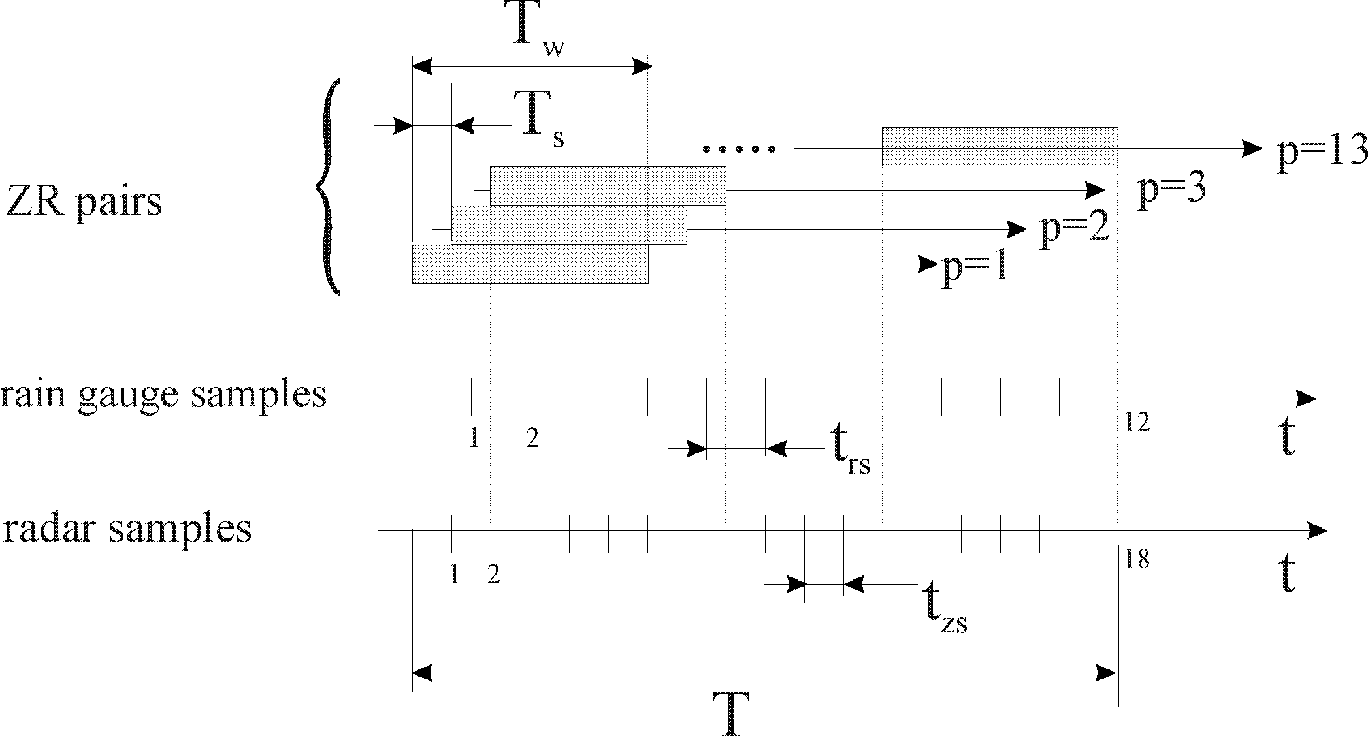
Time parameters
  T Observation time
  t_{rs} Raingauge sampling time
  t_{zs} Radar sampling time
  T_{w} Moving window duration
  T_{s} Time shift
  p Pair index
  2t_{rs=} 3t_{zs}
  T_{s=}t_{zs}
Notes:
Here we have a time diagram where we can see the relative position of all the time parameters we use.
Given the obervation T (press!), for each raingauge we have a number of rainrate samples and a number of radar observations depending on the raingauge samplig time trs (press!) and the radar sampling time tzs (press!).
For each raingauge location we compute a number of pairs, called ZR pairs (press!), on the base on a prefixed mobile window time TW (press!) an a shift time TS (press!).
(press!). In this example, where 2 Trs is equal to 3 tzs, abd TS=trs (press!) we have the window time that allow the data processing of at least 4 rainrate data and at least 6 radar data in order to compute the third ZR pair.
Therefore in the observation time T, we compute a set of ZR pairs once TW and TS are assigned.
Here we obtain 13 ZR pairs

Slide 5
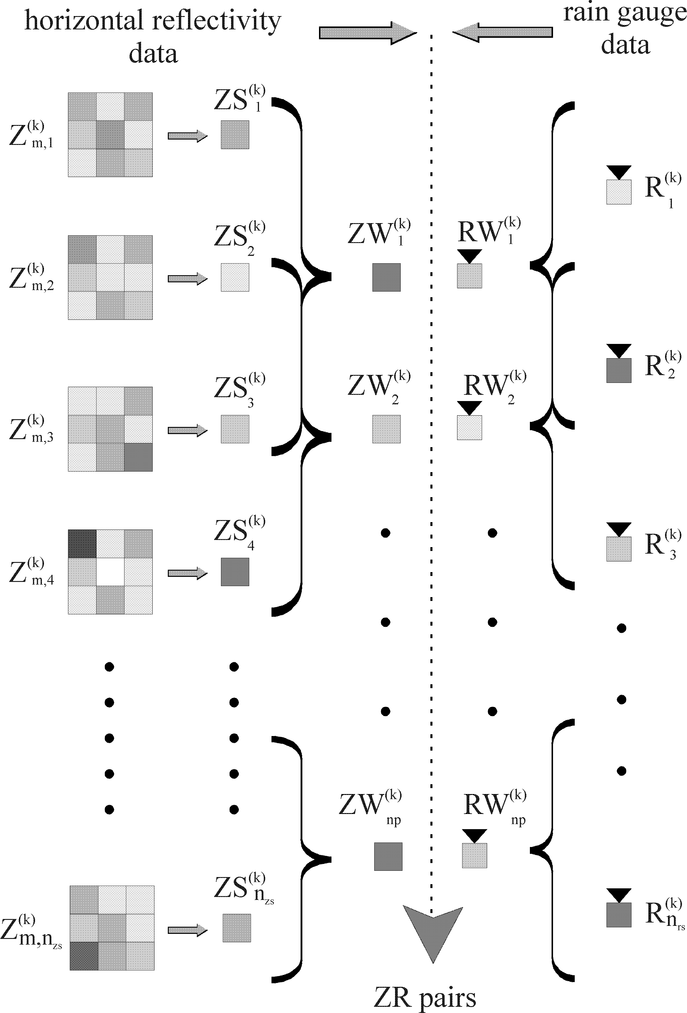
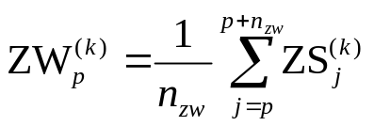
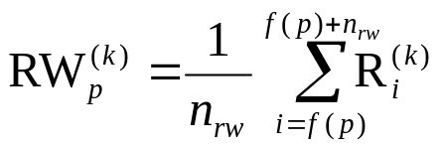
Processing flow to obtain ZR pairs time series at each raingauge site
Time
Notes:
At this point we can see how the ZR values are computed for each raingauge.
Here we have a diagram where on the left we have the radar data composed by a time sequence (top down direction) of 9 adjacet simultaneous reflectivity data and on the right the time sequence of rainrate data.
For each set of adjacent radar data we compute the mean value ZSik (press!) that is an istantaneous space mean value of reflectivity. Then, we compute the mean value ZW (press!) among a number of the ZS values that depends on the window time TW and the radar sampling time.
For the rainrate data we compute the mean value RW (press!) among a number of Rik depending on the window time TW and the rainrate sampling time.
The time sequence (press!) of such ZW and RW values are the ZR pairs

Slide 6
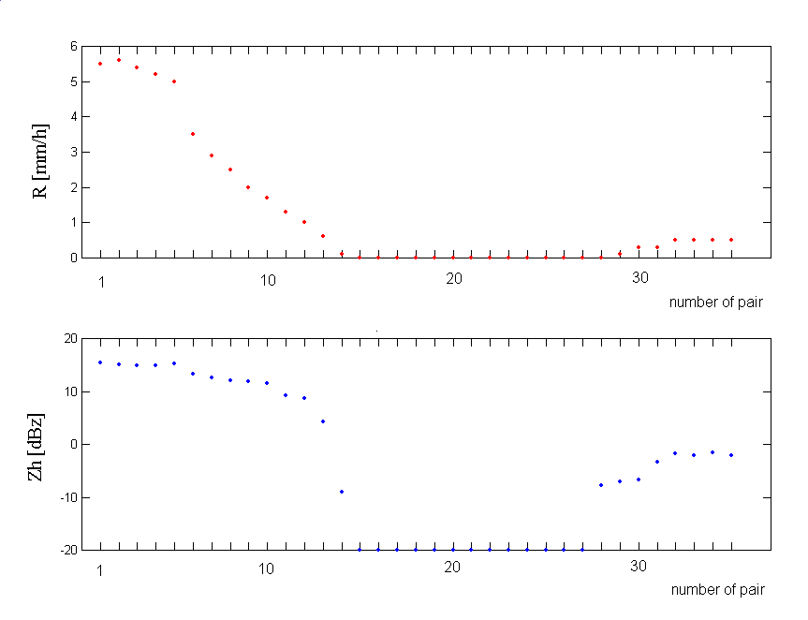
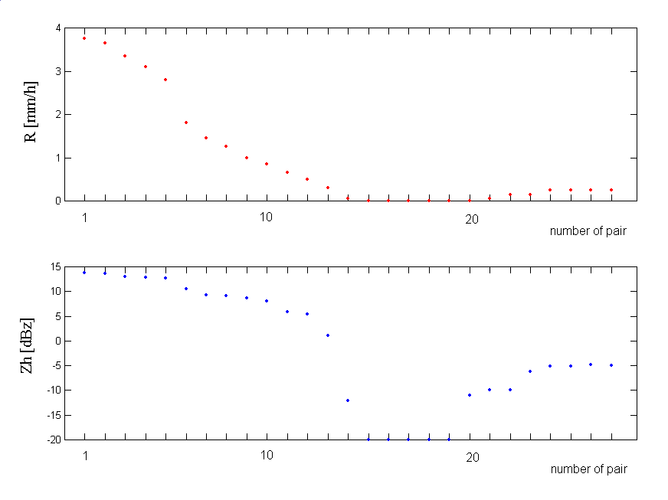
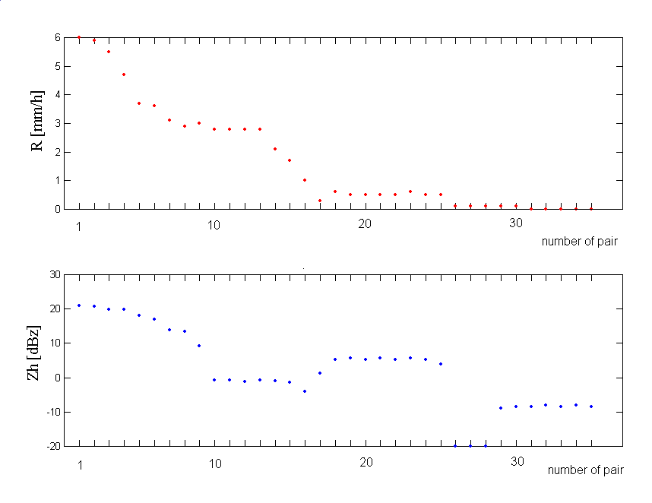
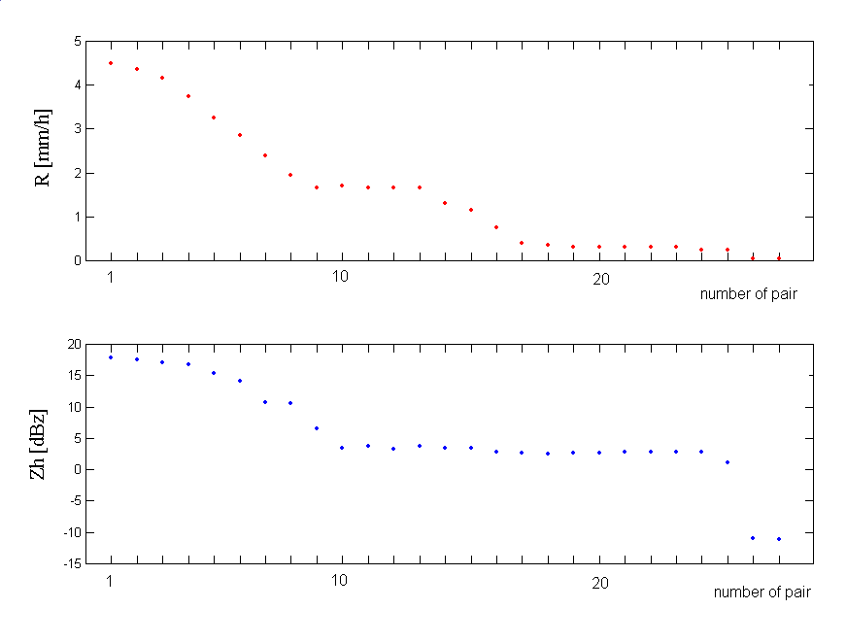
Time series of ZR pairs (T_{s}=15 min, T=640 min)
T_{w}=120 min
T_{w}=240 min
Raingauge 1791
(42.675 km)
West
Raingauge 1095
(16.764 km)
(NEast)
Rainfall phenomenon occurred over Tuscany (Italy) on 21 October 1999 from 11:40:00 to 22:20:00 local time
Notes:
Here we have two different examples about this data processing processing procedure applied on the real data I mentioned before.
In this case we selected TS=15 min and T =640 min, namely all the duration of the considered phenomenon.
On the left the ZR pair with TW=2 hours and on the right TW=4 hours
on the top the rain gauge in West direction and on the bottom the raingauge in NE direction.
the red lines are the R values in mm/hour and the blue lines the Z values in dBz.
Some brief but important considerations:
At the same time(press!), we have different characteristics of the precipitation phenomenon in the two different raingauge locations. Here, for example, there is no rain for 4 hours and here (in the same time, it was raining !
The same values of R (press!) correspond to different values of Z (press!)

Slide 7





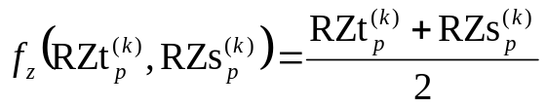

Reliability and uncertainty indexes of the ZR pairs time series
3 parameters of reliability on the ZR pairs have been defined for each raingauge:
rms values of R (time domain)
rms values of Z (time domain)
rms values of Z (space domain)
uncertainty indexes:
Notes:
Now we define some parameters in order to quantify the reliability and the uncertainty of the ZR pairs. What we want to do is to identify a method to check the goodness in the association between the radar data and the raingauge data obtained with the procedure used to compute the ZR pairs .
Therefore 3 parameters of reliability have been computed for each raingauge (press!),
the time rms value of R (press!)
the time rms value of Z (press!)
the space rms value of Z (press!)
By means of this 3 parameters we defined the uncertainty indexes (press!) as function of the 3 rms values, namely
sigma z p (press!) the uncertainty index for the radar data as function Fz of the radar reliability values and sigma r p (press!) for the raingauge data.as function FR of the raingauge reliability values.
In this application we define the function Fz and fr simply as mean value of two reliability parameters for the radar data (press!) and equal to the reliability parameter for the raingauge data (press!).

Slide 8
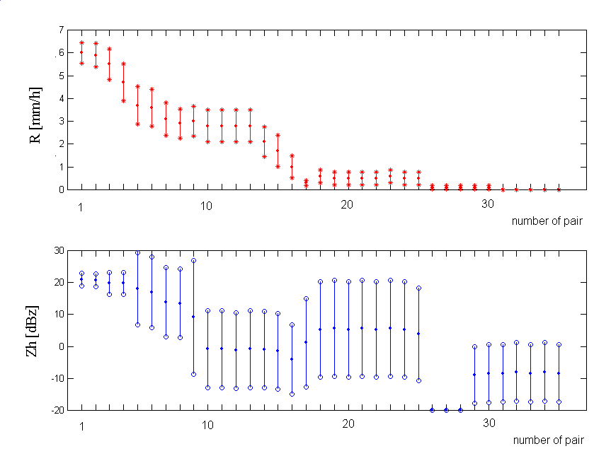
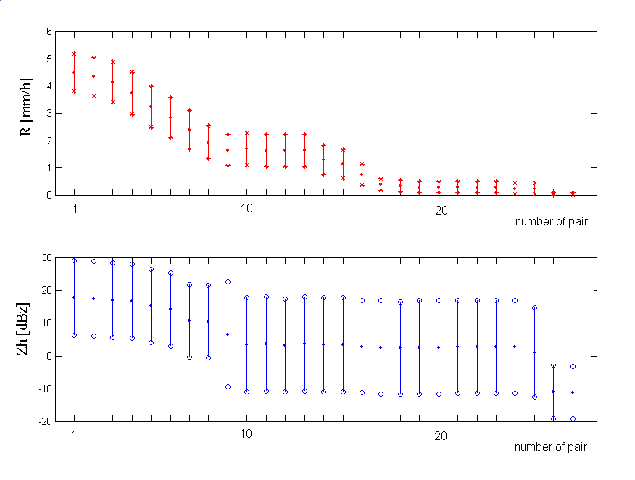
Time series of ZR pairs with uncertainty indexes
T_{w}=120 min
T_{w}=240 min
Raingauge 1095
(16.764 km)
(NEast)
Notes:
Here we have the plot of the ZR pairs with their uncertainty indexes for one of the two raingauge we selected.
On the left the case with TW=2 hours, on the right the case with TW=4 hours
We can note how is the use of the uncertainty indexes, for example we note the change in the dynamic of the radar data in 120 minutes
The meaning of the uncertainty indexes is that if the phenomenon within TW is stationary in time the time reliability parameters go to 0! Then the raingauge uncertainty bar is very small, if the phenomenon within TW is also homogeneous in space the space reliability parameter goes to 0, then the radar uncertainty bar is small.

Slide 9
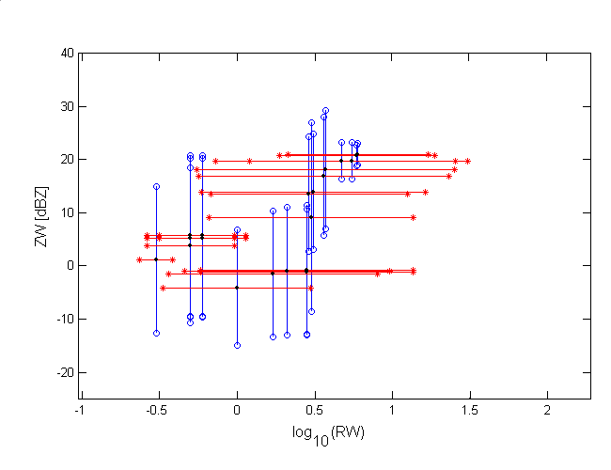
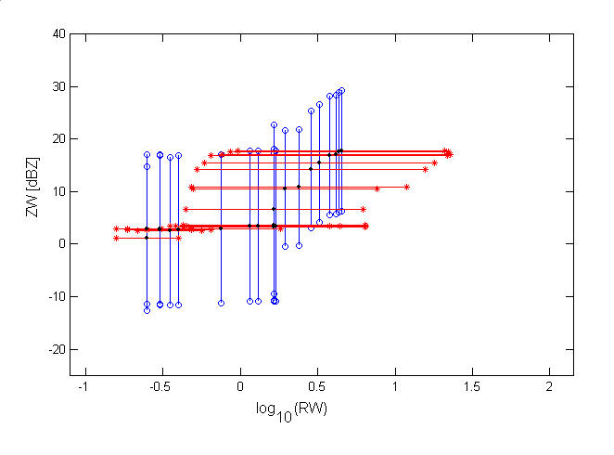
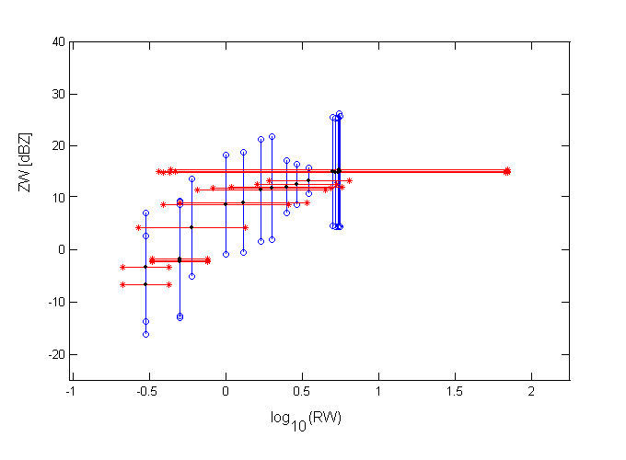
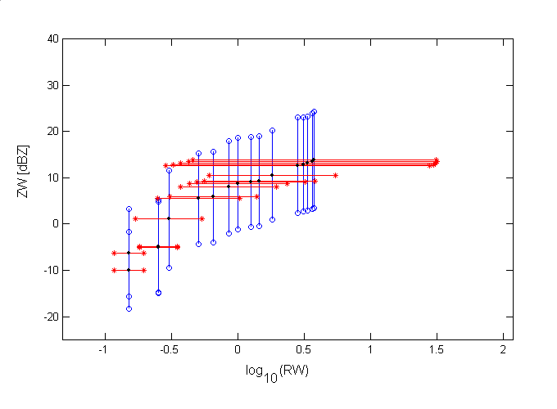
Scatter plots of the ZR pairs
T_{w}=120 min
T_{w}=240 min
Raingauge 1791
(42.675 km)
(West)
Raingauge 1095
(16.764 km)
(NEast)
Notes:
Now we can see the scatter plots between the ZR values with the uncertainty indexes always for 120 minutes on the left an 240 minutes on the right for both raingauge.
As I said before, short bars mean small time space variability for the ZR pair

Slide 10
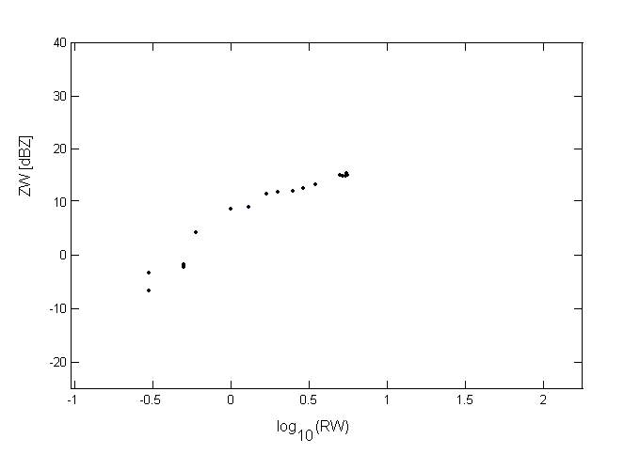
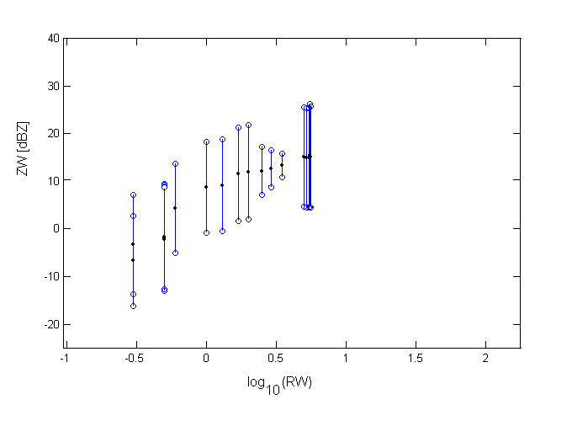

Linear correlation Z-R
1. a standard linear regression method (both uncertainty indexes are not considered)
2. a least square method (radar uncertainty indexes are considered)
    Jay Orear: “Least squares when both variables have uncertainties”, Am. J. Physics, 50(10), Oct 1982, pagg. 912-916
3. an effective variance method (both uncertainty indexes are considered)
A pair of coefficients is computed for each raingauge location (x_{k},y_{k})
Notes:
At this point we must find the relation between Z data and R data separately for each raingauge.
We decide to use a liner relationship to correlate the ZR pairs in the logarithmic domain.
If we don’t use the uncertainty indexes we assume that all the ZR pairs have the same weight, (press!) then a standard liner regression method is used among all the ZR pairs. (press!)
If we use the uncertainty indexes on the radar data we assume that only the Z data have uncertainty and then (press!) a least square method ca be used. (press!)
Finally, if we use both uncertainty indexes (press!) an effective variance method is the most suitable procedure.
For the examples reported in the following we select the easiest one, (press!) the standard linear regression method.
(press!) The regression method applied in all the raingauge gives a set of coefficients A0k B0k

Slide 11
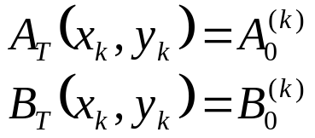
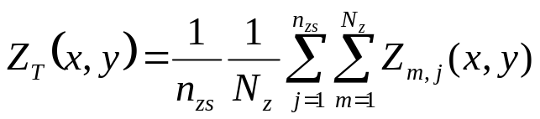
Computation of the functions A_{T} , B_{T} and Z_{T}
In the raingauge locations (x_{k},y_{k})
The values of A_{T} and B_{T} in all the other points (x,y) are computed by range weighted average over the ensembles {A_{T} (x_{k},y_{k})} and {B_{T} (x_{k},y_{k})}, respectively
In all other points (x,y)
In all points (x,y)
number of adjacent radar cells
number of radar scans within the obs. time T
Notes:
Remeber that we have to determine the function AT BT and ZT in the whole 2D domain in order to use such eq. for the rainfall rate computation.
(press!) Therefore we assign the regression coefficients A0k and B0K (different for each raingauge) in the raing gauge locations
(press!) While in all other points the funciont AT and BT are computed by a weigthed average depending on the relative raingauge distances.
(press!) For the function ZT in all points it is simply the time-space mean value (press!) of the adjacent reflectivity radar data Zmj over the position x,y collected during the whole observation time T.

Slide 12
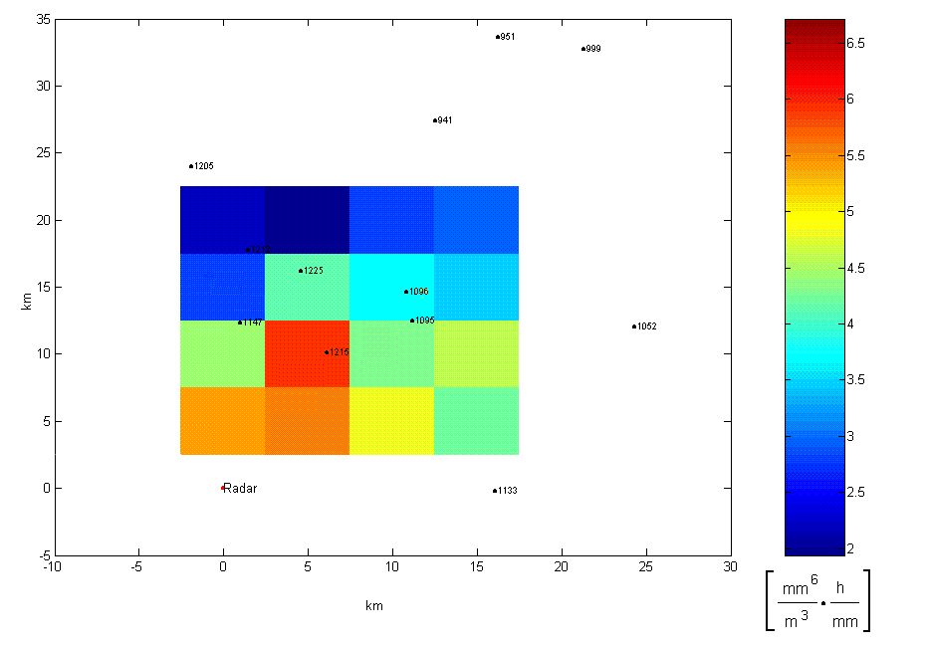
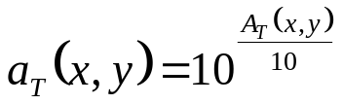
Computation of the R_{T} map - 1° step: A_{T} (x,y)
Range-weighted average among the 4 closest raingauges
grid resolution: 5 x5 km
pixel: (10,20) km
Notes:
Here we have an example of AT computation.
Let us suppose to compute the rainfall rate in the point 10 20 km (press!) with a grid resolution of 5 x 5 km.
(press!) The value of AT in this point (blue color) is the weighted average among the A0k of the (press!) 4 closest raingauge: one for each 4 quadrants.
The weights (press!) are the rain gauge distances.
Here the numerical values and then, the unit of measurement, are related to a small letter T (press!) that is given by such eq.

Slide 13
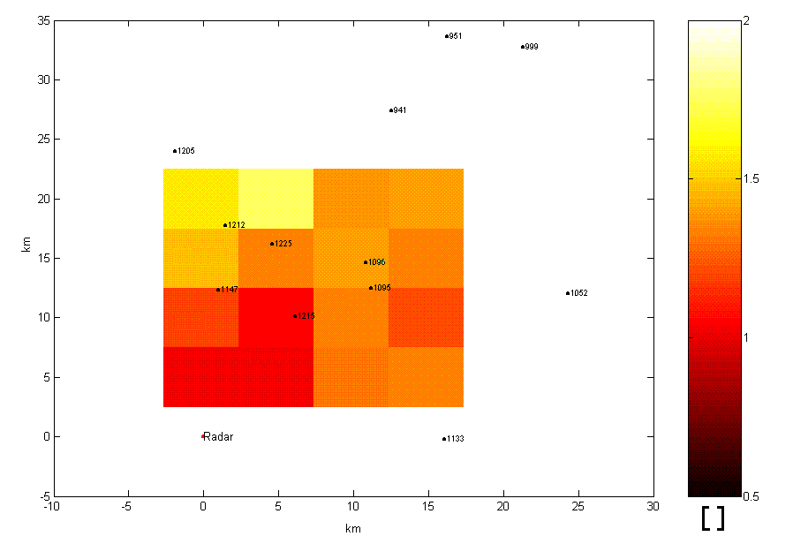
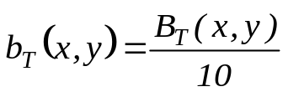
Computation of the R_{T} map - 2° step: B_{T} (x,y)
Range-weighted average among the 4 closest raingauges
grid resolution: 5 x5 km
pixel: (10,20) km
Notes:
Here we have the example for the BT function computation.
The procedure is the same as that described for AT computation
Here BT small letter (press!) is given by such eq. with respect to BT and it has no dimension.

Slide 14


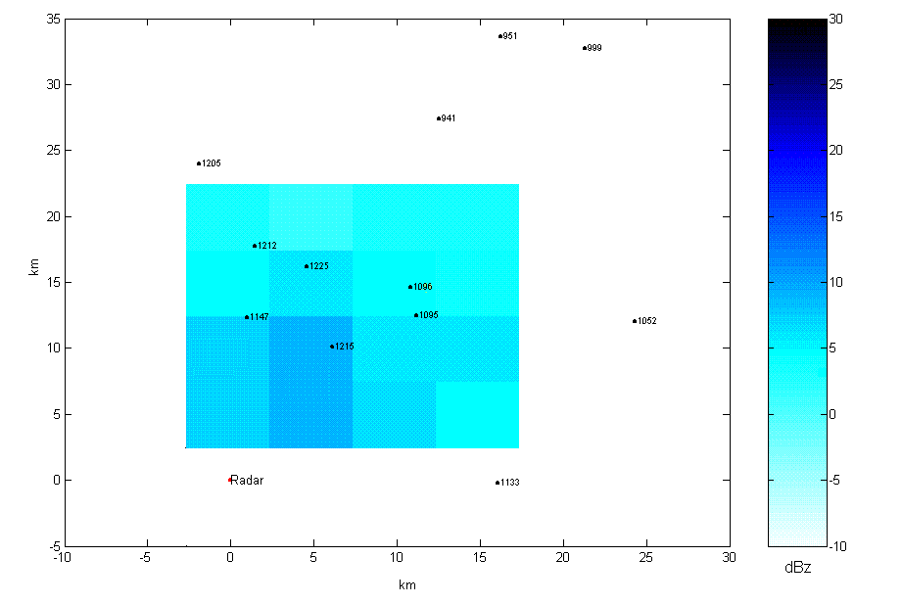
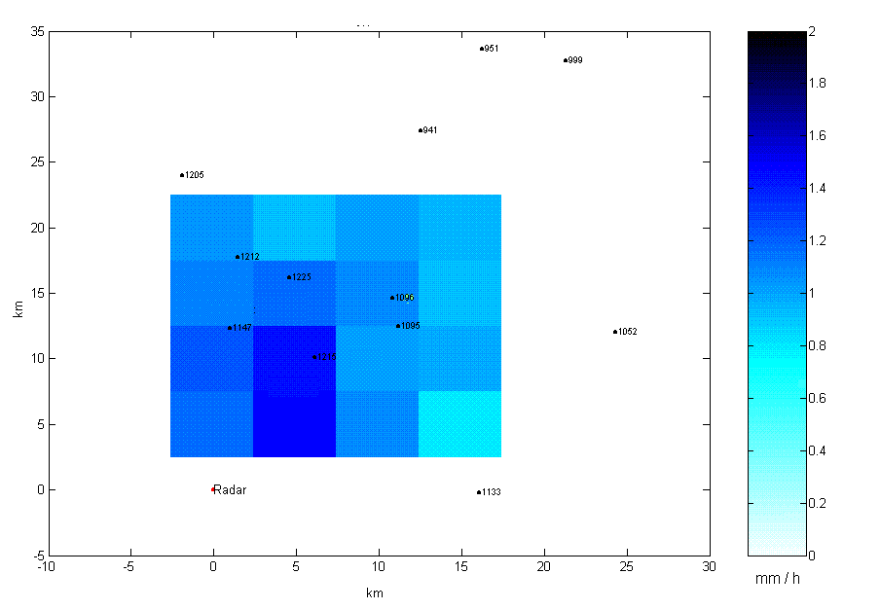


Z R
Computation of the R_{T} map - 3° step: R_{T} (x,y)
Notes:
Finally, we can compute the rainfall rate: the function At (press!) , BT (press!) and ZT (press!) give the average rainfall rate in the observation time T over all the area x,y pixel by pixel (press!).

